Slide 1
Operating systems
Lecture #4

Slide 2
Content Lecture#4
01
File Descriptor
02
Standard File Descriptor
03
InterProcess COmmunication
04
Pipes
05
Descriptor Table

Slide 3

Lets take a Break
The wife asks: "Run to the store and pick up a loaf of bread. While you are there, get eggs." The programmer never came back.
A programmer's wife tells him: "Run to the store and pick up a loaf of bread. And if they have eggs, get a dozen" The programmer comes home with 12 loaves of bread

Slide 4
Revising Previous Lecture
Important System Calls Used in OS
fork()
Processes use this system call to create processes that are a copy of themselves. With the help of this system Call parent process creates a child process, and the execution of the parent process will be suspended till the child process executes.
exec()
This system call runs when an executable file in the context of an already running process that replaces the older executable file. However, the original process identifier remains as a new process is not built, but stack, data, head, data, etc. are replaced by the new process.
exit():
The exit() system call is used to terminate program execution. Specially in the multi-threaded environment, this call defines that the thread execution is complete. The OS reclaims resources that were used by the process after the use of exit() system call.
kill():
The kill() system call is used by OS to send a termination signal to a process that urges the process to exit. However, a kill system call does not necessarily mean killing the process and can have various meanings.
wait()
In some systems, a process needs to wait for another process to complete its execution. This type of situation occurs when a parent process creates a child process, and the execution of the parent process remains suspended until its child process executes.
The suspension of the parent process automatically occurs with a wait() system call. When the child process ends execution, the control moves back to the parent process.

Slide 5
Inter Process Communication
Cooperating process can affect or be affected by other processes, including sharing data reasons for cooperating processes:
File Descriptor
A file descriptor is an unsigned integer used by a process to identify an open file.

Slide 6
Standard Descriptor
When a file or a device opens an integer is given as descriptor. And through this descriptor file is accessed. 3 descriptors are fixed
File descriptor # | Purpose | Posix Name | Stdio stream
0 | Standard input | STDIN_FILENO | stdin
1 | standard output displayed using printf(); | STDIN_FILENO | stdout
2 | standard error displayed using perror(); | STDIN_FILENO | stderr
A descriptor table is associated with every process and PCB holds its pointer. Standard descriptor can also be replaced for any other file and done by write() system file.
Size_t Write(int fd, void* buf, size_t cnt)
Parameter
Fd: file descriptor
Buf: buffer to write data to(add of the buffer)
Cnt: length of the buffer
Returns How many bytes were actually written
Return Number of bytes written on success
Return 0 on reaching end of file
Return -1 on error
Return -1 on the signal interrupt

Slide 7
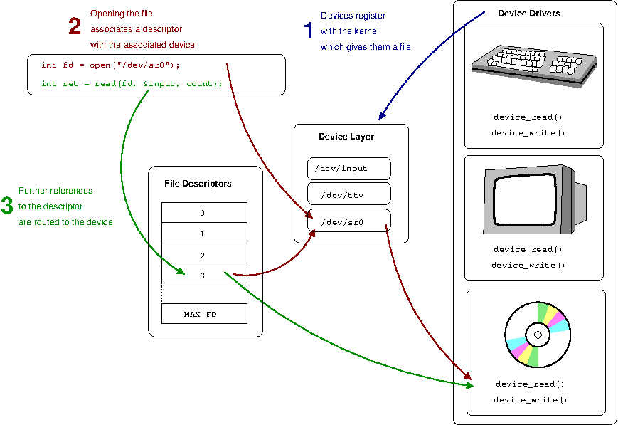
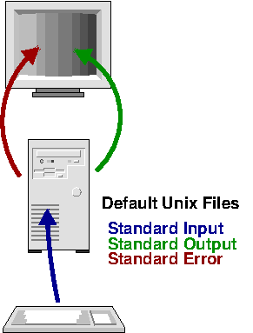
File descriptor

Slide 8
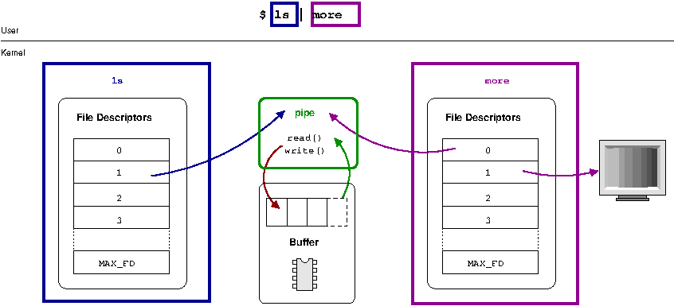
File Descriptor

Slide 9
Standard Descriptor
100 is passed
#include <stdio.h>
#include <sys/types.h>
#include <unistd.h>
#include <stdlib.h>
#include <errno.h>
#include <sys/wait.h>
int main(int argc, char const *argv[])
{
char array[100];
int n = read(0,array,100);
write(1,array,100);
return 0;
}
2 is passed for error so programmer know if this is output or error
#include <stdio.h>
#include <sys/types.h>
#include <unistd.h>
#include <stdlib.h>
#include <errno.h>
#include <sys/wait.h>
int main(int argc, char const *argv[])
{
char array[100];
int n = read(0,array,100);
write(2,array,100);
return 0;
}
Read 5 bytes but diplay 100 bytes
#include <stdio.h>
#include <sys/types.h>
#include <unistd.h>
#include <stdlib.h>
#include <errno.h>
#include <sys/wait.h>
int main(int argc, char const *argv[])
{
char array[100];
int n = read(0,array,5);
write(1,array,100);
return 0;
}
#include <stdio.h>
#include <sys/types.h>
#include <unistd.h>
#include <stdlib.h>
#include <errno.h>
#include <sys/wait.h>
int main(int argc, char const *argv[])
{
char array[100];
int n = read(0,array,100);
write(1,array,n);
return 0;
}
https://www.onlinegdb.com/online_c_compiler#

Slide 10
Inter Process Communication
Cooperating process can affect or be affected by other processes, including sharing data reasons for cooperating processes:
Information sharing
Computation speedup
Modularity
Convenience
Cooperating processes need inter-process communication (IPC)
Methods to communicate among processes and called inter Process communication
Pipes (Anonymous pipes (used for IPC between parent child or siblings)
Named Pipes (FIFO)file created on disk every king of Process can communicate through this
Shared memory (memory created among communicating process and shared area is created by any one of the process used for bulk data)
Socket (Two process runs on different machines)
Message Passing Message passing is a high level IPC mechanism Message is a piece of information that is passed from one process to another

Slide 11
Inter Process Communication
Pipes
A mechanism in which the output of one process is directed into input of another
Pipe is one-way communication only i.e we can use a pipe such that One process write to the pipe, and the other process reads from the pipe. It opens a pipe, which is an area of main memory that is treated as a “virtual file”.
A pipe file is created by using pipe() system call
A pipe can be accessed like an ordinary file (FIFO queue)
The read and write operations may become blocked if the queue is empty (on read) and full (on write)
If a process tries to read before something is written to the pipe, the process is suspended until something is written.
Pipes exist only as along as the processes which creates them
When a pipe is closed, the pipe file is destroyed
The pipe system call finds the first two available positions in the process’s open file table and allocates them for the read and write ends of the pipe.
Socket
A socket is defined as an endpoint for communication
Concatenation of IP address and port
The socket 161.25.19.8:1625 refers to port 1625 on host 161.25.19.8
Communication consists between a pair of sockets

Slide 12
Inter Process Communication
Shared memory
Processes share memory region for communication
User processes control communication (not OS)
For large amount of data transfer
Issue of process synchronization
shmget : A process use it to create the shared segment in memory
It returns a segment id
shmat : It is used to access shared memory
It returns the address of shared memory, enabling a reference
Shmdt : It detaches the shared memory from calling process
shmctl : It sets control parameter or destroys a shared segment
Message passing
No shared variables
Establish communication link
Pass message using send(m) and receive(m)
For small amount of data transfer (fixed or variable length messages)
Direct or indirect communication, blocking or non-blocking
Easier to implement for distributed systems
Time consuming

Slide 13
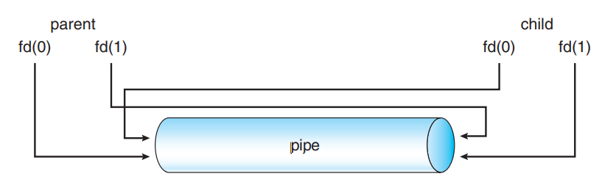
PIPE
#include <stdio.h>
#include <sys/types.h>
#include <unistd.h>
#include <stdlib.h>
#include <errno.h>
#include <sys/wait.h>
int main(int argc, char const *argv[])
{
int fd[2];
pipe (fd);
if (fork() == 0)
{
char array[10];
read(fd[0],array,10);
printf("%s",array);
}
else
{
write(fd[1],"Helosdfffoo", 6);
wait(NULL);
}
}
Anonymous Pipe
int pipe (int fd[2])
Create a pipes and places descriptors of write & read
fd[0] will be the fd(file descriptor) for the read end of pipe.
fd[1] will be the fd for the write end of pipe.
Returns : 0 on Success.
-1 on error.
Pipe is always unidirectional
UNIX treats a pipe as a special type of file Thus, pipes can be accessed using ordinary read() and write() system calls

Slide 14
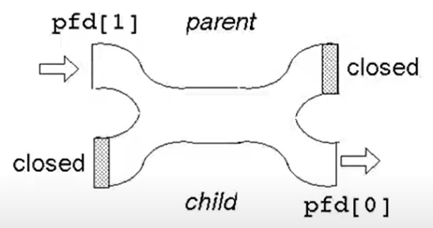
PIPES
Synchronization Mechanism
If PIPE is empty read call will be blocked
If PIPE is full write call will be blocked
If all write ends are closed for a PIPE read will return 0 EOF
If read ends are closed write will generate SIGPIPE Signal
Write and read process’s own unused pipe end will prevent it from throwing SIGPIP/returning EOF

Slide 15
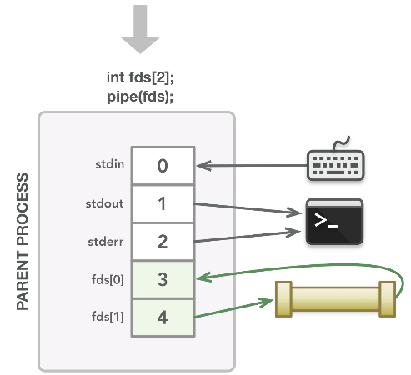
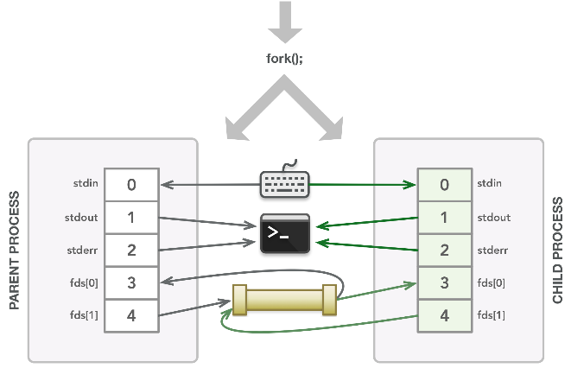
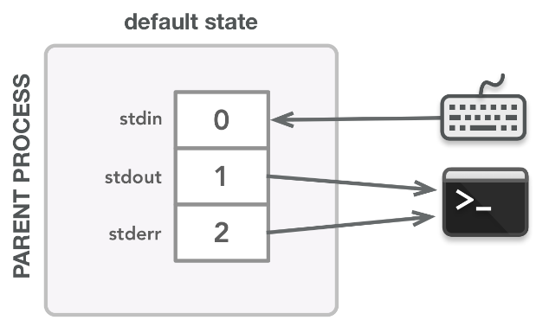
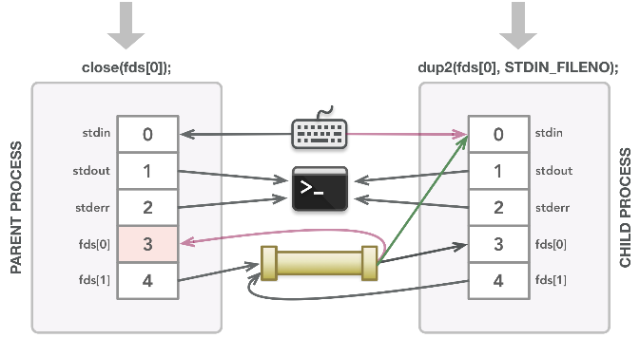
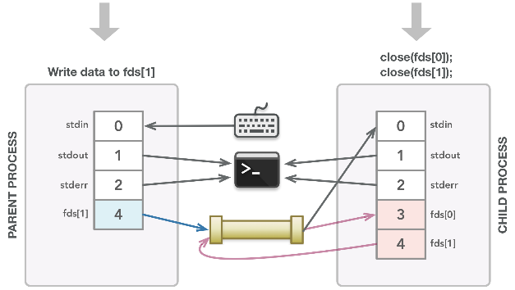
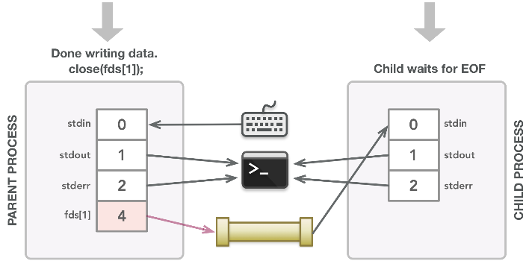
PIPES

Slide 16
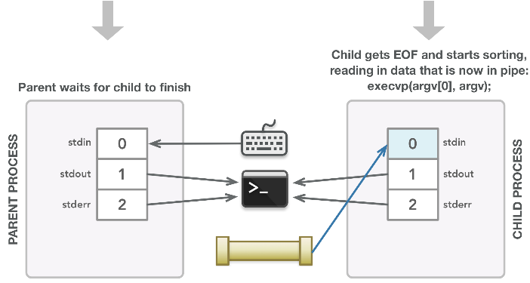
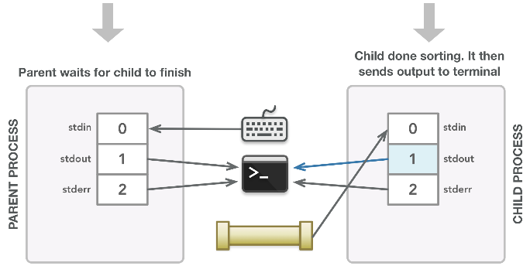
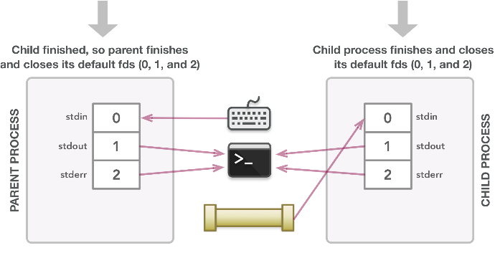
PIPE

Slide 17
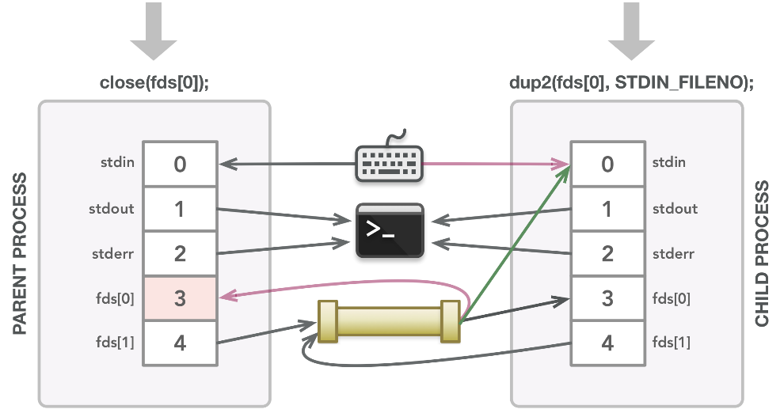
Descriptor table
#include <stdio.h>
#include <stdlib.h>
#include <unistd.h>
int main(void) {
int pipefds[2];
if(pipe(pipefds) == -1) {
perror("pipe");
exit(EXIT_FAILURE);
}
printf("Read File Descriptor Value: %d\n", pipefds[0]);
printf("Write File Descriptor Value: %d\n", pipefds[1]);
return EXIT_SUCCESS;
}

Slide 18
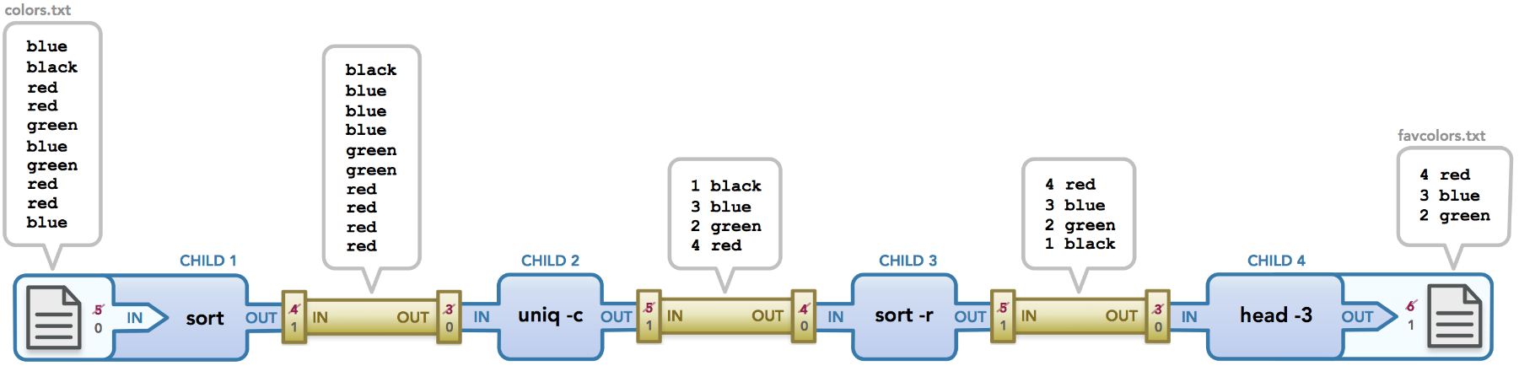
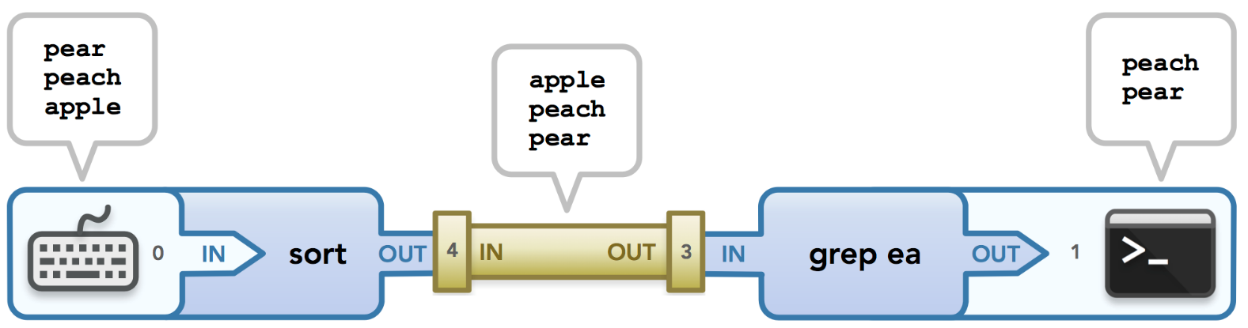
PIPES
sort | grep ea

Slide 19
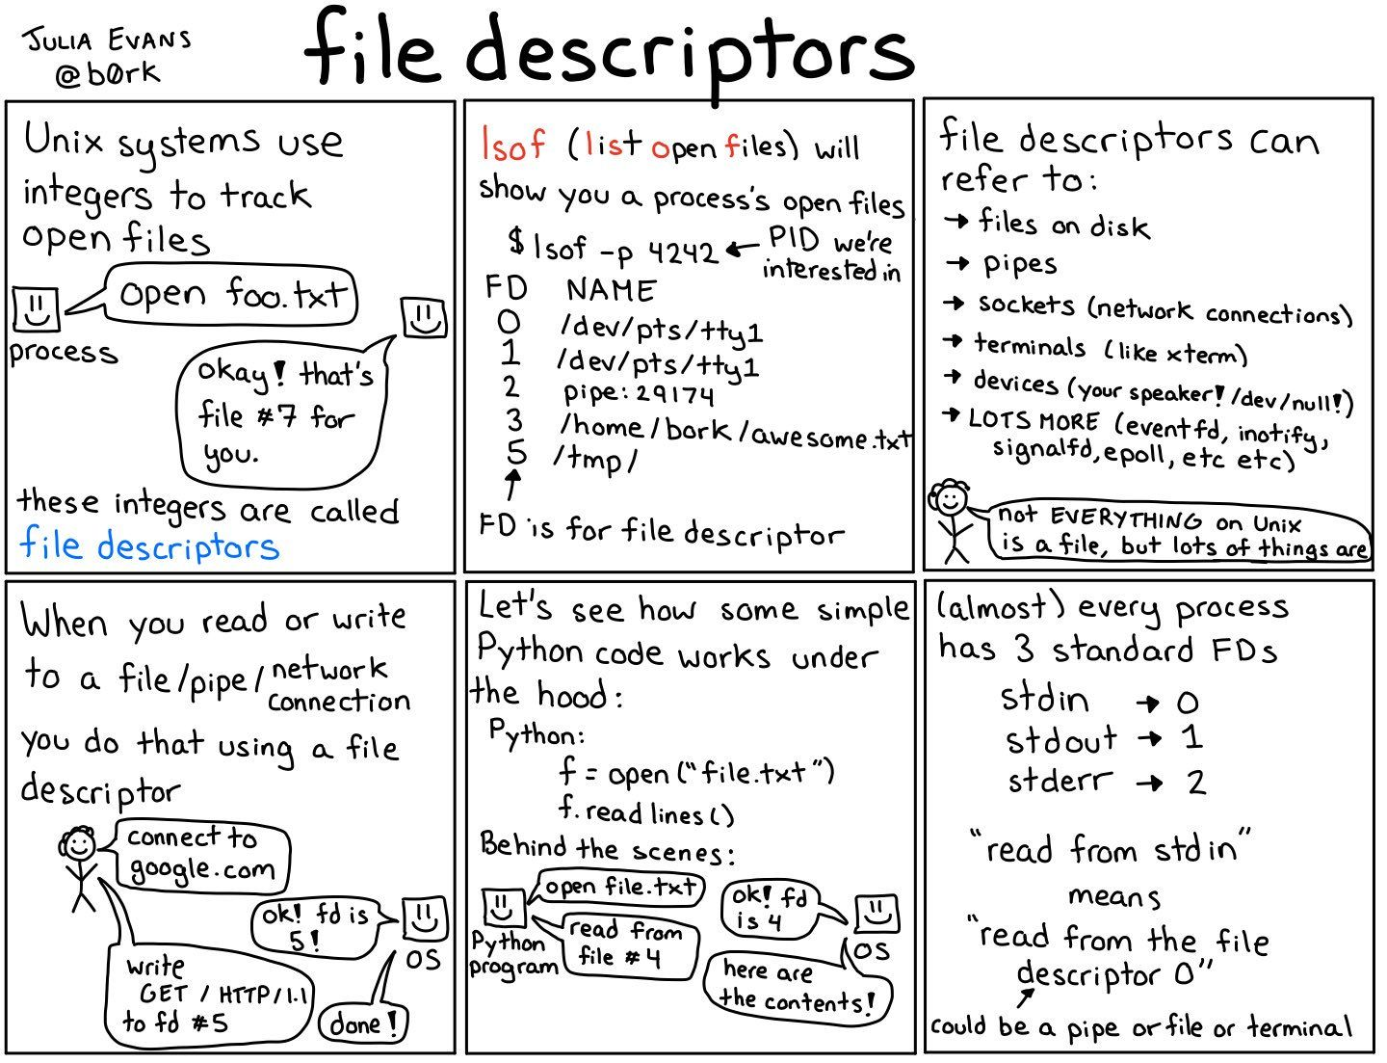
Descriptor table

Slide 20
Lab
Run exec and file descriptor

Slide 21
Thank you

